Slide 1
Building Asian Climate Change Scenarios by Multi-Regional Climate Models Ensemble
S. Wang, D. Lee, J. McGregor, W. Gutowski , K. Dairaku, X. Gao, S. Hong, Y. Wang, K. Kurihara, J. Katzfey , Y. Lee
RMIP and follow-up Project Teams
Contact: wsy@nju.edu.cn

Slide 2
Outlines
RMIP
Model evaluation and Asian regional climate projection
Asian climate and changes
Summer Monsoon Systems
Follow-up project and future development

Slide 3
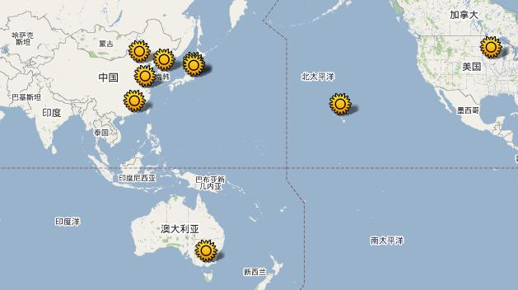
History of Regional Collaboration
CMA, IAP
SNU, YSU, KMA
RMIP: Regional climate Model Intercomparison Project for Asia
In April 2000, APN approved RMIP to support the further development of regional climate and environment models through inter-comparisons, and their applications for Temperate East Asia.
NJU
ISU
NIED, MRI
HKCU
HU
CSIRO
universities, research institutes, government sponsored research agencies;
scientists working on modelling, observation, and end users;

Slide 4
RMIP:
Multi-RCM Ensemble System for Asian Climate and Change
Emissions
ECHAM
Regional Climate Models
RMIP: I
Seasonal cycle & Extremes
RMIP: II
Asian
Climatology
RMIP: III
Asian Regional Climate Projection
RMIP: Regional climate Model Intercomparison Project
Notes:
Three phases of RMIP

Slide 5
Activities for RMIP III
Projecting high resolution regional climate change for 2040-2070 for Asia by using the ensemble of nice regional climate models;
Based on the RCM simulations, detecting and assessing the sources and magnitudes of uncertainty in Asian climate change projection;
Calculating the change and variance of controlling climate factor of Asian climate, i.e., Asian monsoon system, and its impacts on Asian climate;
Exploring and developing new methods and techniques for regional climate model outputs ensemble.

Slide 6
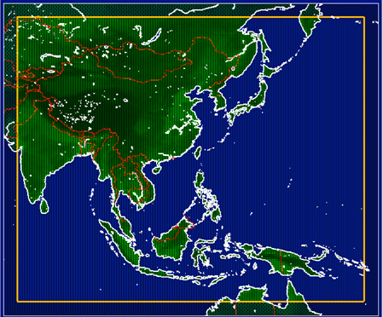
Domain，Time slices and Sub-regions
Region 2
Arid/semi arid area
Region 3
North China
Region 1
Korea/Japan
Region 6
Tibet
Region 4
Centre China
Region 8
India
Region 7
Southeast
Asia
Region 5
South China
Region 9
North Maritime Continent
Projection
Region 10
South Maritime Continent
Projected climate
Near future
Control climate
1980
2000
2020
2040
2060
2080
2100

Slide 7
Models and Data Availability
 | Model | Group | Country
1 | CCAM | CSIRO | Australia
2 | CCAM-60KM | CSIRO | Australia
3 | NIED-RAMS | NIED | Japan
4 | MRI_RCM | MRI | Japan
5 | ReGCM3 | CMA | China
6 | GRIMs | YSU | Korea
7 | iRCM | IU | USA
8 | WRF | NJU | China
9 | WRF_SN | NJU | China
10 | WRF_RRTM | NJU | China
11 | SNU RCM | SNU | Korea
12 | ReGCM3 | NJU | China
Notes:
Note that the data will be available to the public in 3 months

Slide 8
Model outputs and Observation
For surface climate:
Daily average MSLP, maximal/minimal temperature, surface wind speed
3-hourly: 2m temperature, RH, convective precipitation, large scale precipitation, evaporation, 10m wind (U,V), surface radiation (up/downward shortwave radiation, up/downward longwave radiation), latent heat, sensible heat, column soil moisture, total runoff
For upper level atmosphere
Daily average: U, V, T, H at 200, 500, 850 hPa
3-hourly: radiation fluxes at TOA, cloud fraction, surface precipitable water
Observation
CRU surface temperature, OISST SST
APHRODITE and GPCP Precipitation

Slide 9
Ongoing Analyses for RMIP III
Multi-model Ensemble with uncertainty addressed
-Surface climate
-Climate variations
-East Asian Monsoon
-Indian Monsoon
-Heat waves
-Heavy rainfall and flood
Regional Climate Change
Asian
Monsoon
Systems
Single model evaluation
Extremes

Slide 10
Asian Climate and Changes
Indian Subcontinent and Tibet

Slide 11
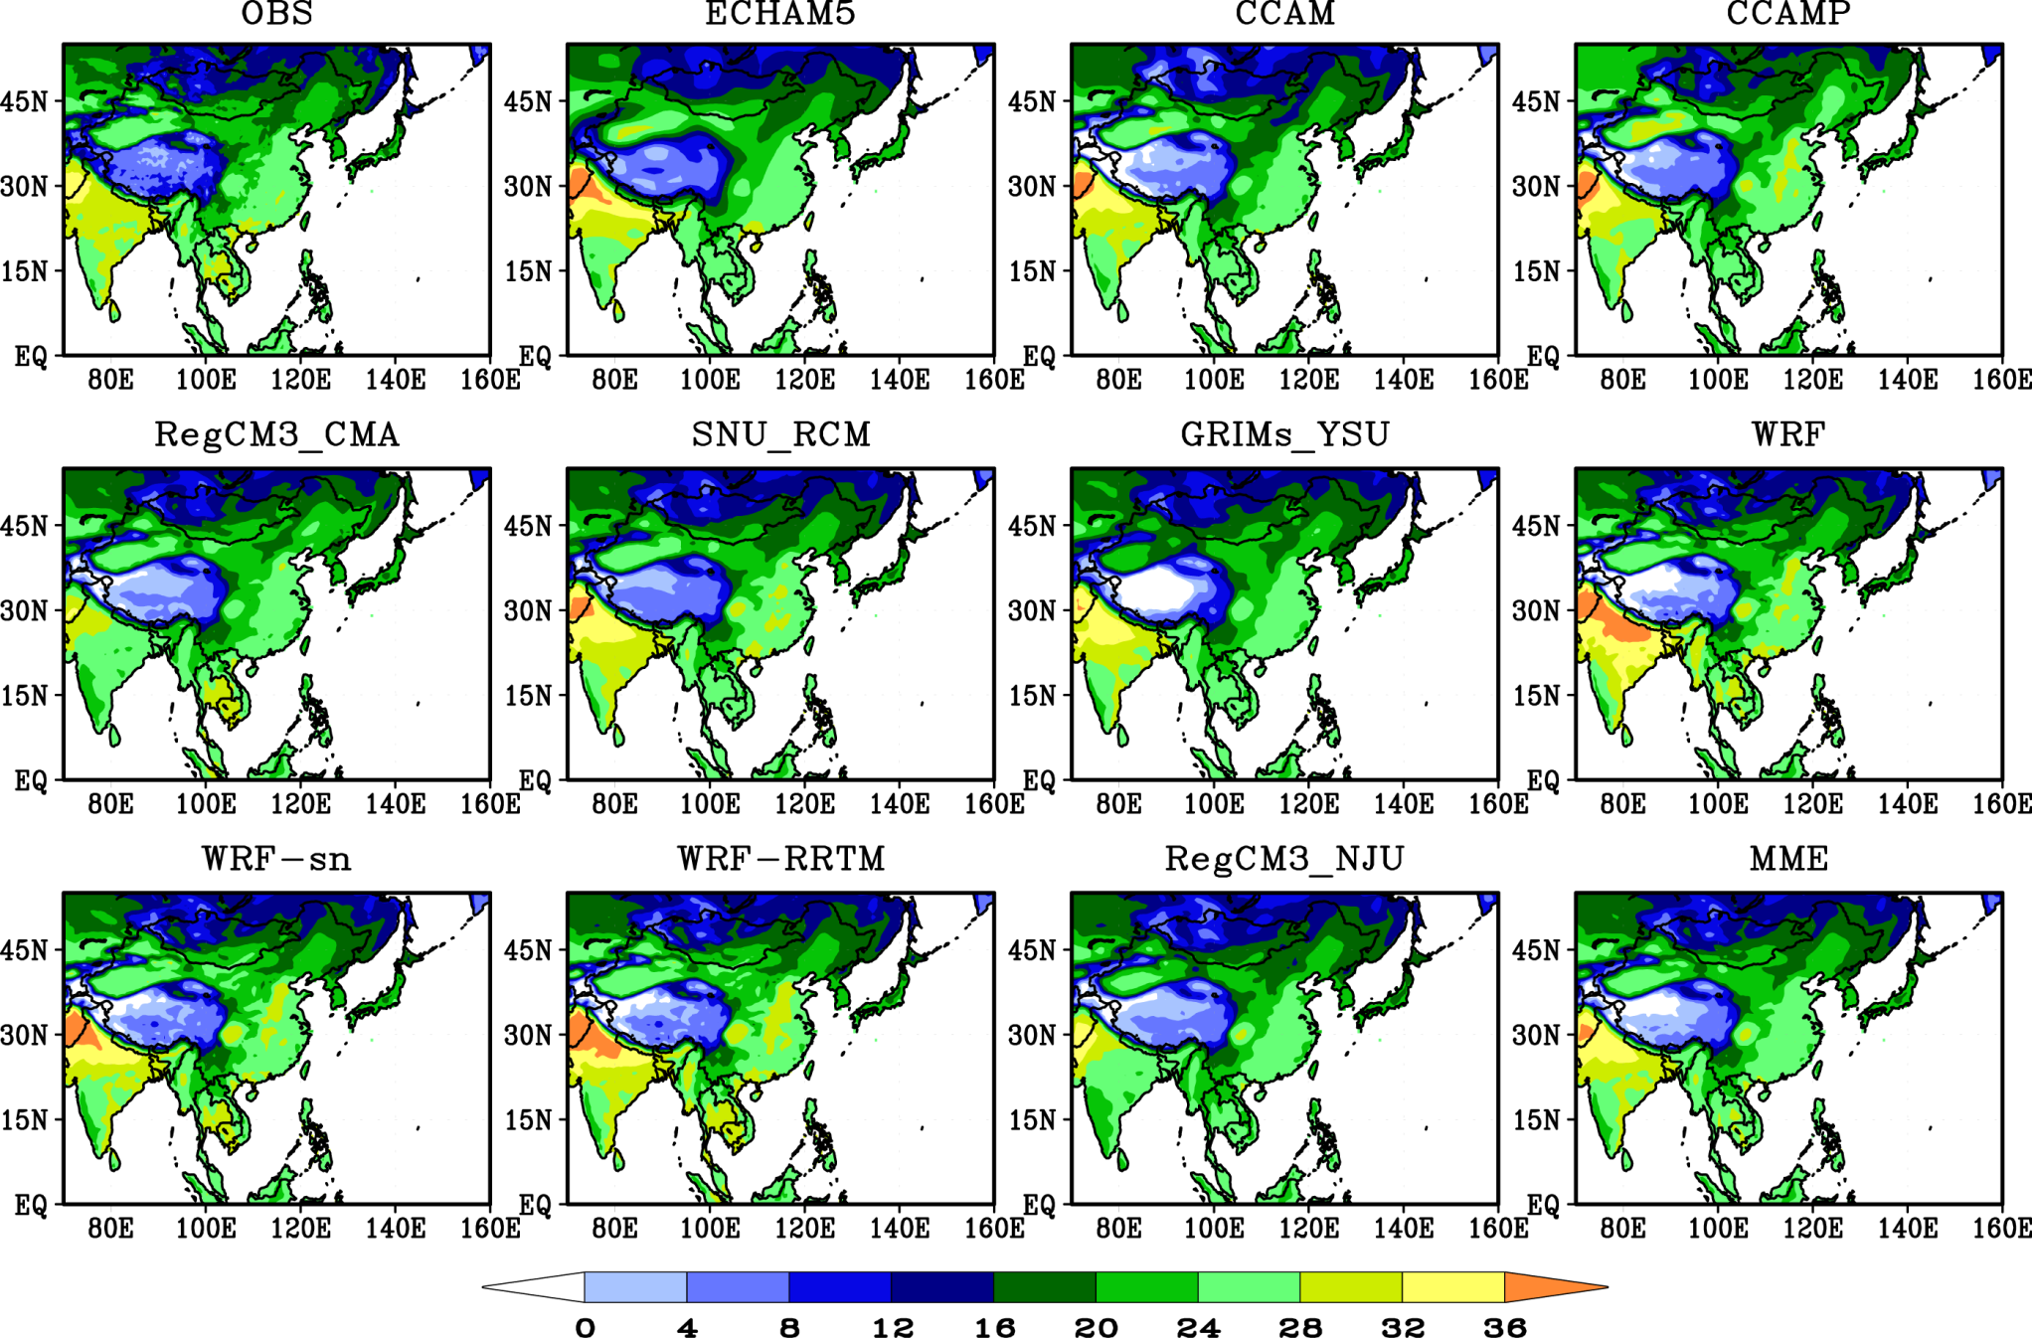
20-year (1981-2000) Averaged Surface Air temperature (JJA, C)

Slide 12
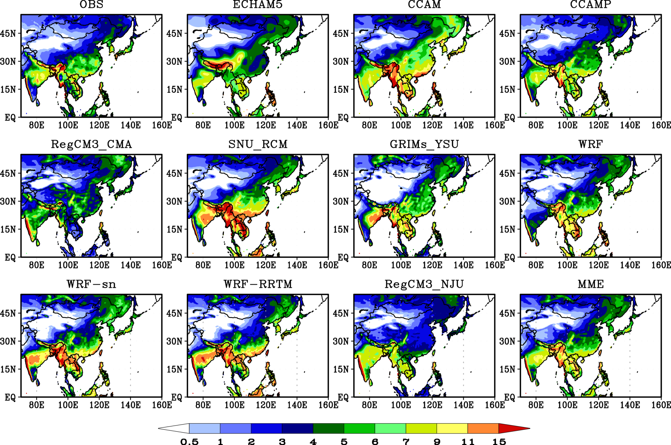
20-year (1981-2000) Averaged precipitation (JJA, mm/d)

Slide 13
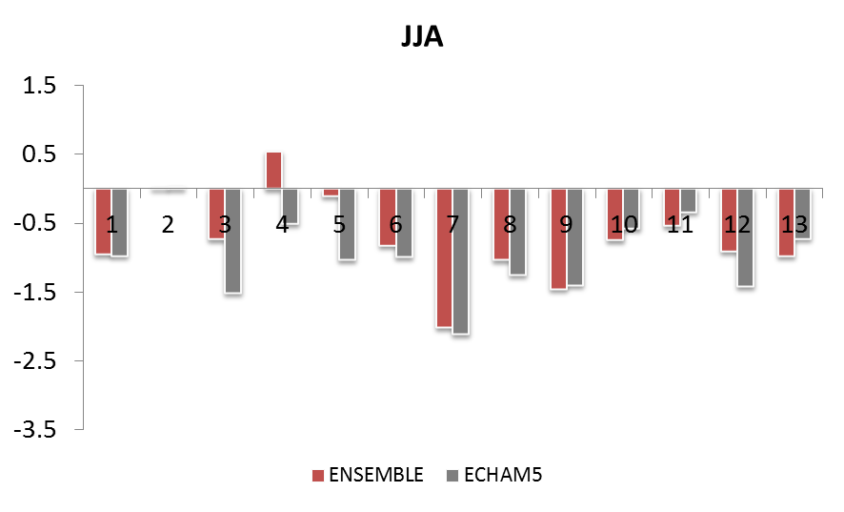
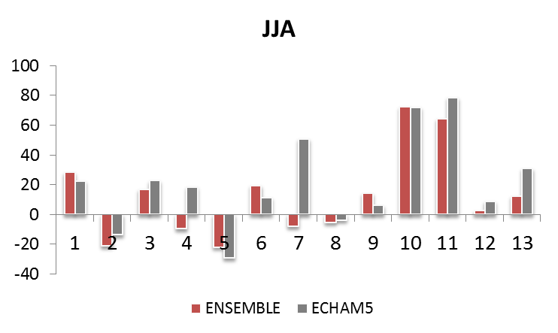
Summer surface climate BIASES in different sub-regions
1, Asia
2, Korea/Japan
3, Arid/Semi arid area
4, North China
5, Center China
6, South China
7, Tibet
8, Southeast Asia
9, India Subcontinent
10, North Maritime
11, South Maritime
12, Land
13, Ocean
ΔT (℃)
ΔP (%)
Both driving GCM and RCMs are colder than observation;
Smaller biases in temperature by RCMs than ECHAM5;

Slide 14
Biases in T | Annual | JJA | MAM | SON | DJF
Asia | -1.48 | -0.95 | -1.52 | -1.54 | -1.92
Land | -1.71 | -0.91 | -2.15 | -1.86 | -1.92
Ocean | -1.60 | -0.98 | -1.22 | -1.63 | -2.58
Tibet | -2.84 | -2.02 | -3.10 | -2.90 | -3.33
Indian Subcontinent | -1.29 | -1.46 | -0.86 | -1.44 | -1.40
Biases in P (%) | Annual | JJA | MAM | SON | DJF
Asia | 43.42 | 28.13 | 60.08 | 34.23 | 60.49
Land | 16.38 | 2.4 | 51.66 | 0.36 | 78.72
Ocean | 24.85 | 12.18 | 48.89 | 15.97 | 44.96
Tibet | 20.76 | -8.06 | 85.53 | 14.12 | 233.9
Indian Subcontinent | 34.01 | 14.12 | 128.73 | 22.03 | 54.76

Slide 15
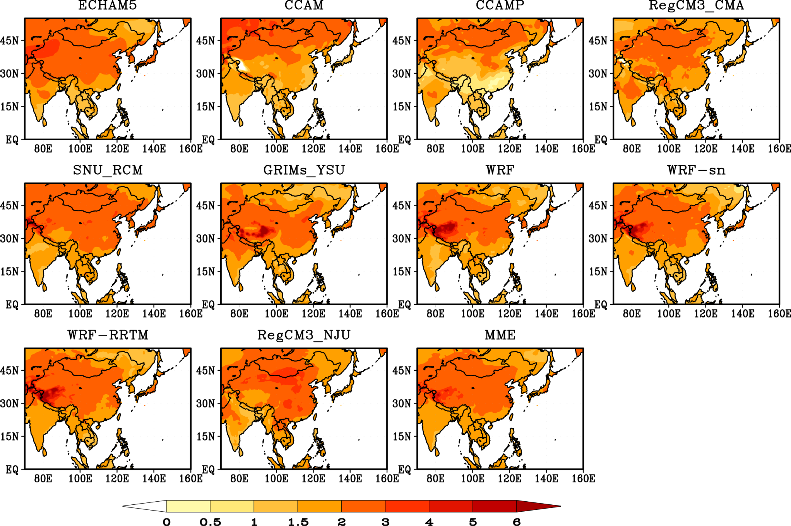
Projection of surface air Temperature Changes (JJA, C)

Slide 16
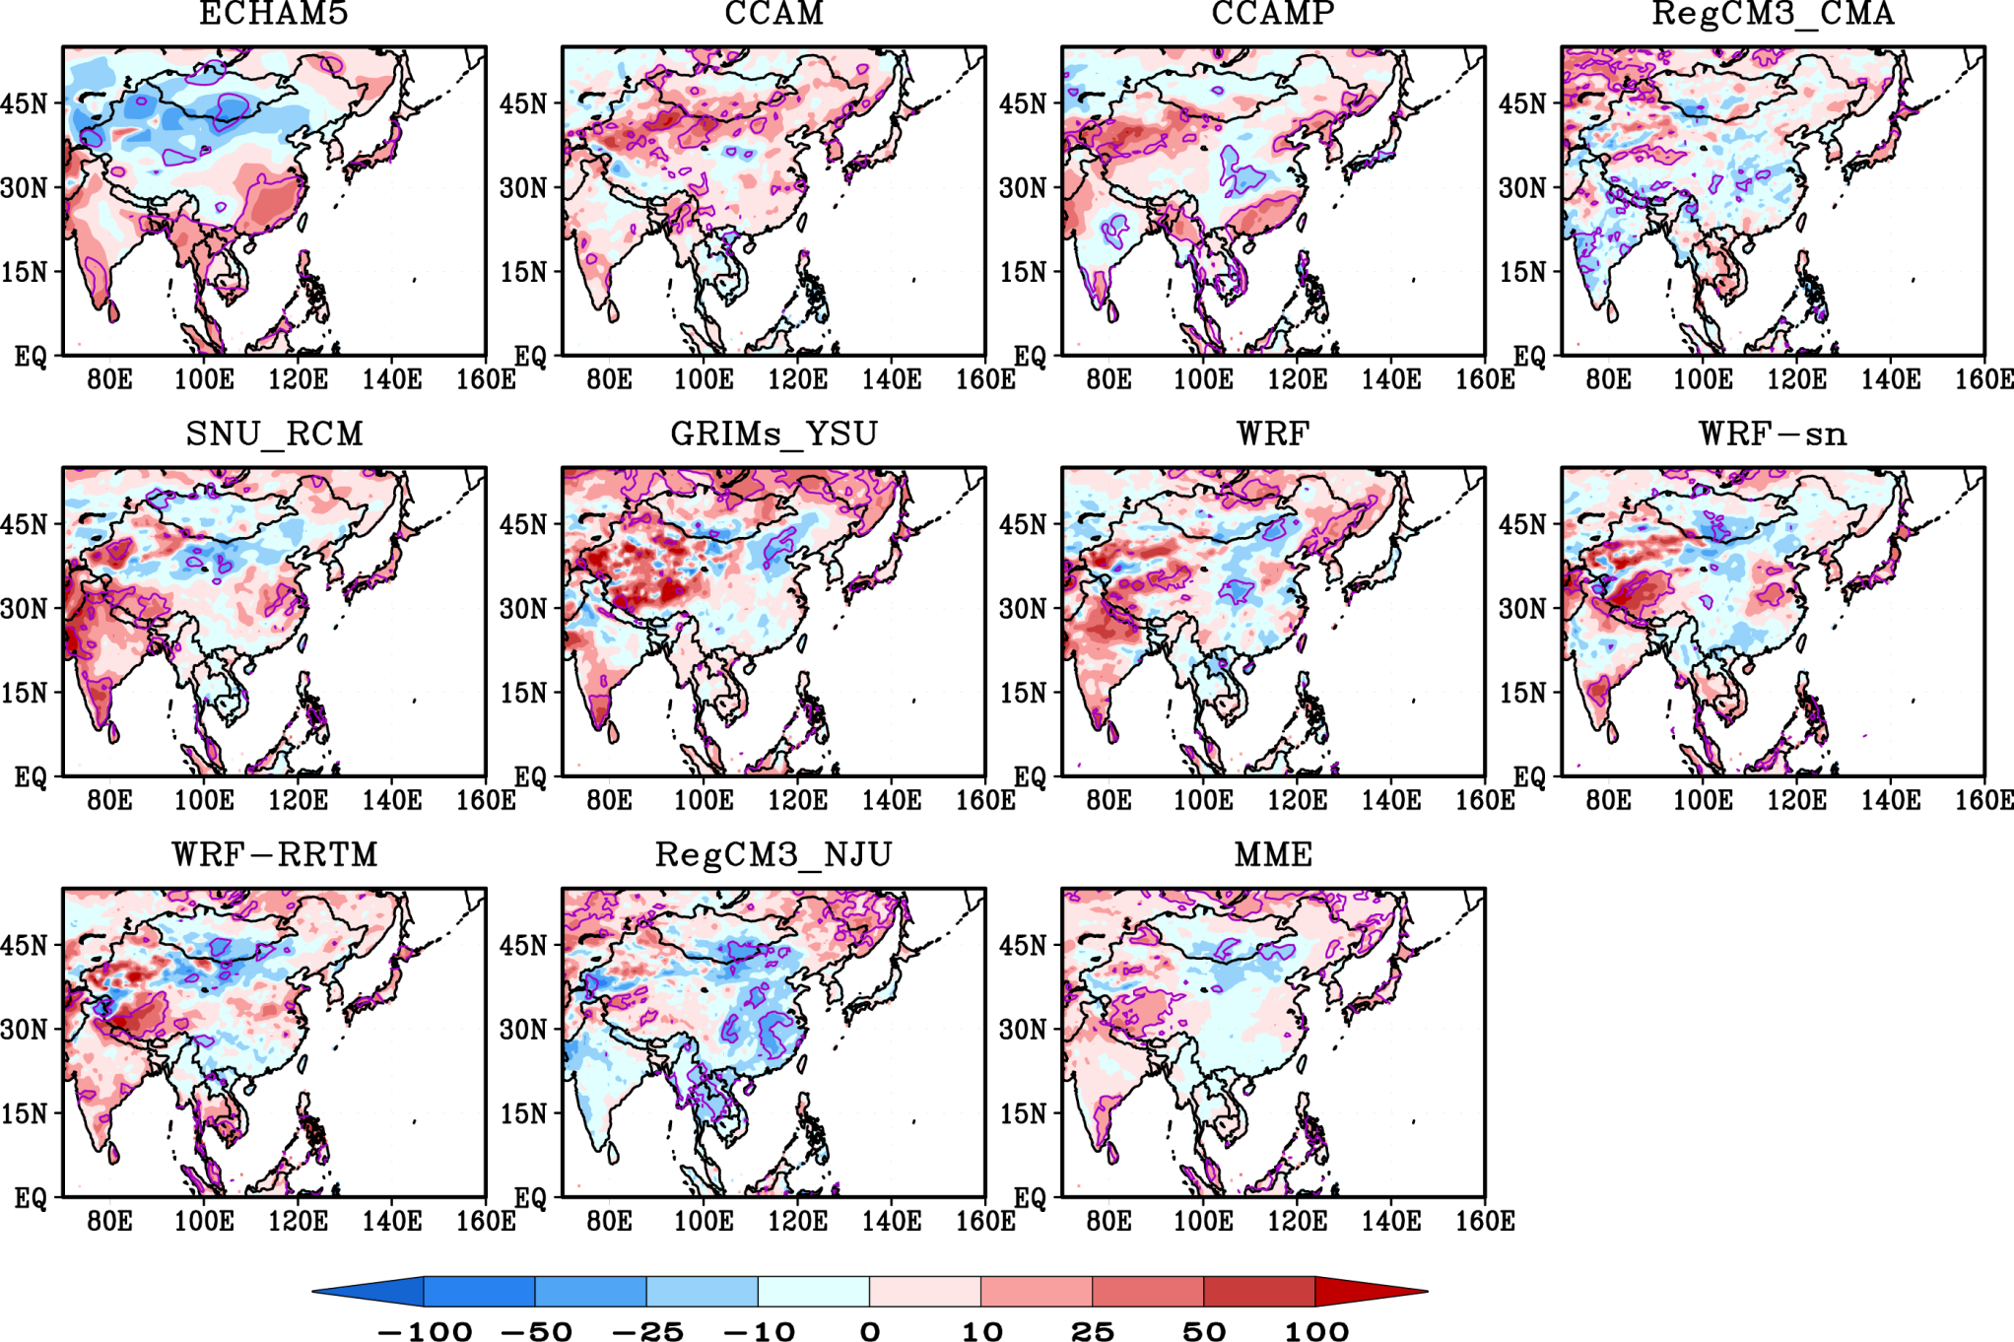
Projection of precipitation changes(JJA, %)
(future-current)
current
*100
Purple lines mean the differences are
significant at a 95% or greater
confidence level

Slide 17
Sub-regional climate changes for JJA
1, Asia
2, Korea/Japan
3, Arid/Semi arid area
4, North China
5, Center China
6, South China
7, Tibet
8, Southeast Asia
9, Indian Subcontinent
10, North Maritime
11, South Maritime
12, Land
13, Ocean
T(C)
Both driving GCM and RCMs project warmer and wetter climate for SA and India;
Relative large difference between RCMs and GCM concerning Precipitation

Slide 18
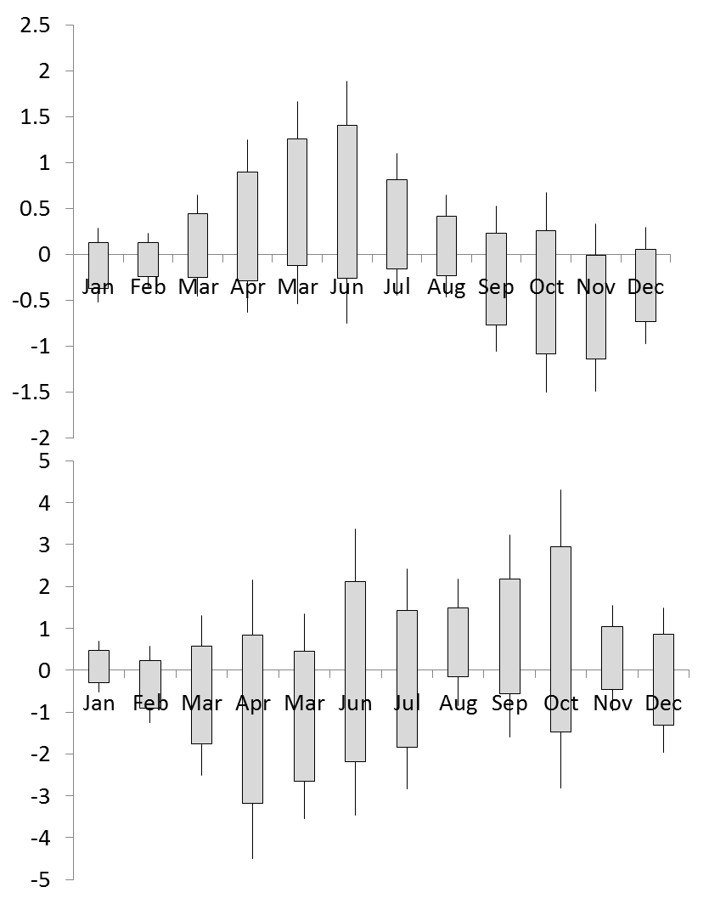
Seasonal Cycle of Precipitation Change over Tibet and Indian Subcontinent
Tibet
P (mm/d)
Indian Subcontinent
P (mm/d)

Slide 19
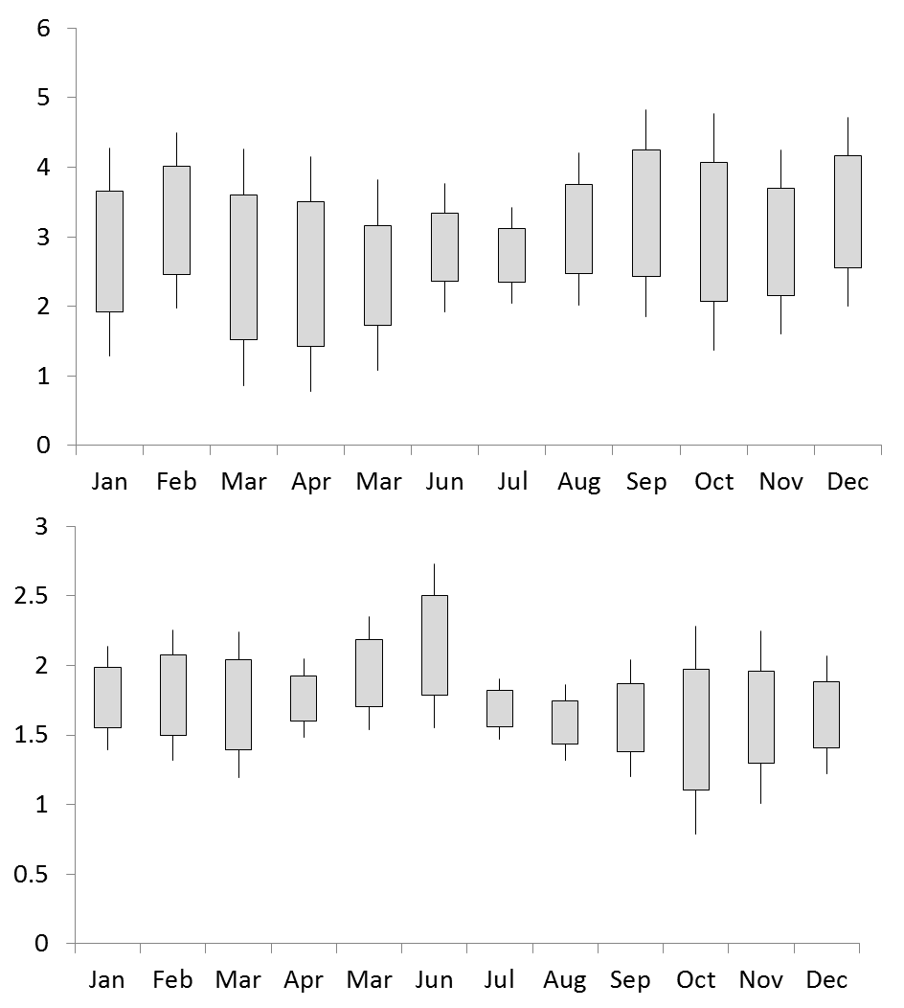
Seasonal Cycle of Temperature Change over Tibet and Indian Subcontinent
Tibet
T (C)
Indian Subcontinent
T (C)

Slide 20
Annual Temperature variation by multi-model Ensemble(C)
Indian subcont.
Asia
Tibet
For current climate, Tibet experiences more warming in both observation and simulation; the observed warming is actually more significant.
Comparing to the rest of Asian subregions, Tibet will have more severe warming in the near future.

Slide 21
Projected regional changes of T and P by multi-model Ensemble(C)
Changes in T | Annual | JJA | MAM | SON | DJF
Asia | 1.964 | 1.921 | 1.895 | 1.974 | 2.067
Land | 2.545 | 2.387 | 2.311 | 2.618 | 2.863
Ocean | 1.700 | 1.722 | 1.683 | 1.665 | 1.731
Tibet | 2.816 | 2.861 | 2.637 | 2.706 | 3.058
Indian Subcontinent | 1.706 | 1.775 | 1.806 | 1.532 | 1.712
Changes in P (%) | Annual | JJA | MAM | SON | DJF
Asia | 2.46 | 2.4 | 2.61 | 1.73 | 3.14
Land | 5.23 | 4.83 | 9.89 | 2.67 | 1.69
Ocean | 2.78 | 3.21 | -0.15 | 4.55 | 2.69
Tibet | 0.98 | 4.46 | 7.39 | -8.55 | -11.19
Indian Subcontinent | 2.28 | 4.58 | -10.4 | 9.62 | -1.55

Slide 22
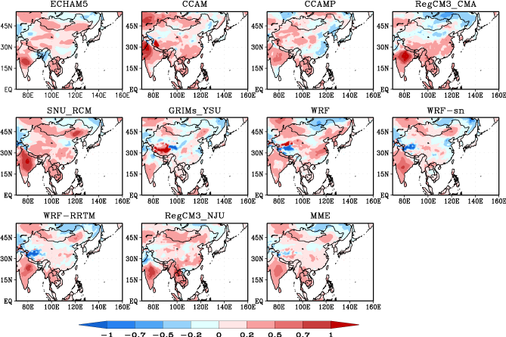
Projected changes of Interannual Variability of T(C, JJA)
Notes:
Mean climate,

Slide 23
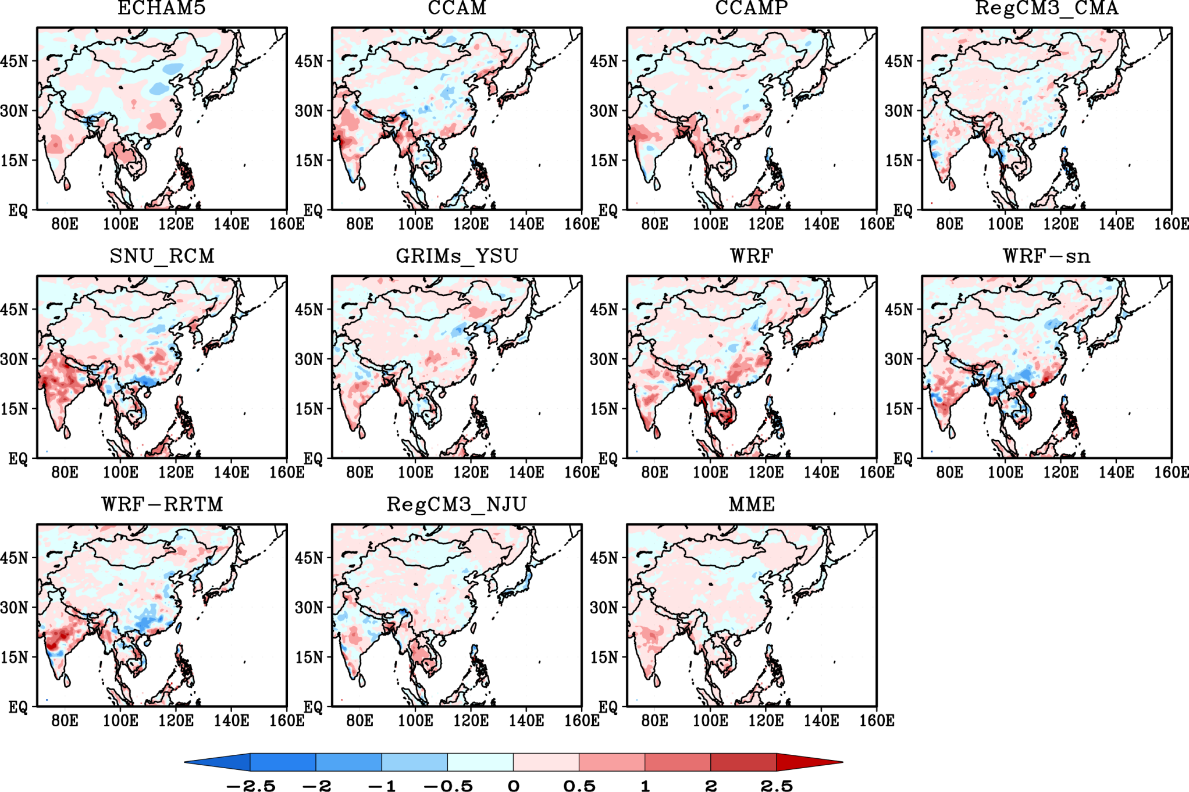
Projected changes of Interannual Variability of Precipitation (mm/d, JJA)

Slide 24
Asian Monsoon Precipitation and Changes
Indian Summer Monsoon

Slide 25
Multi model simulation of IM precipitation
Present climate (1981-2000)
Future change (2041-2060) under scenario A1B
Climatology
Interannual variability
Progresses
Climatology
Interannual variability
Monsoon index

Slide 26
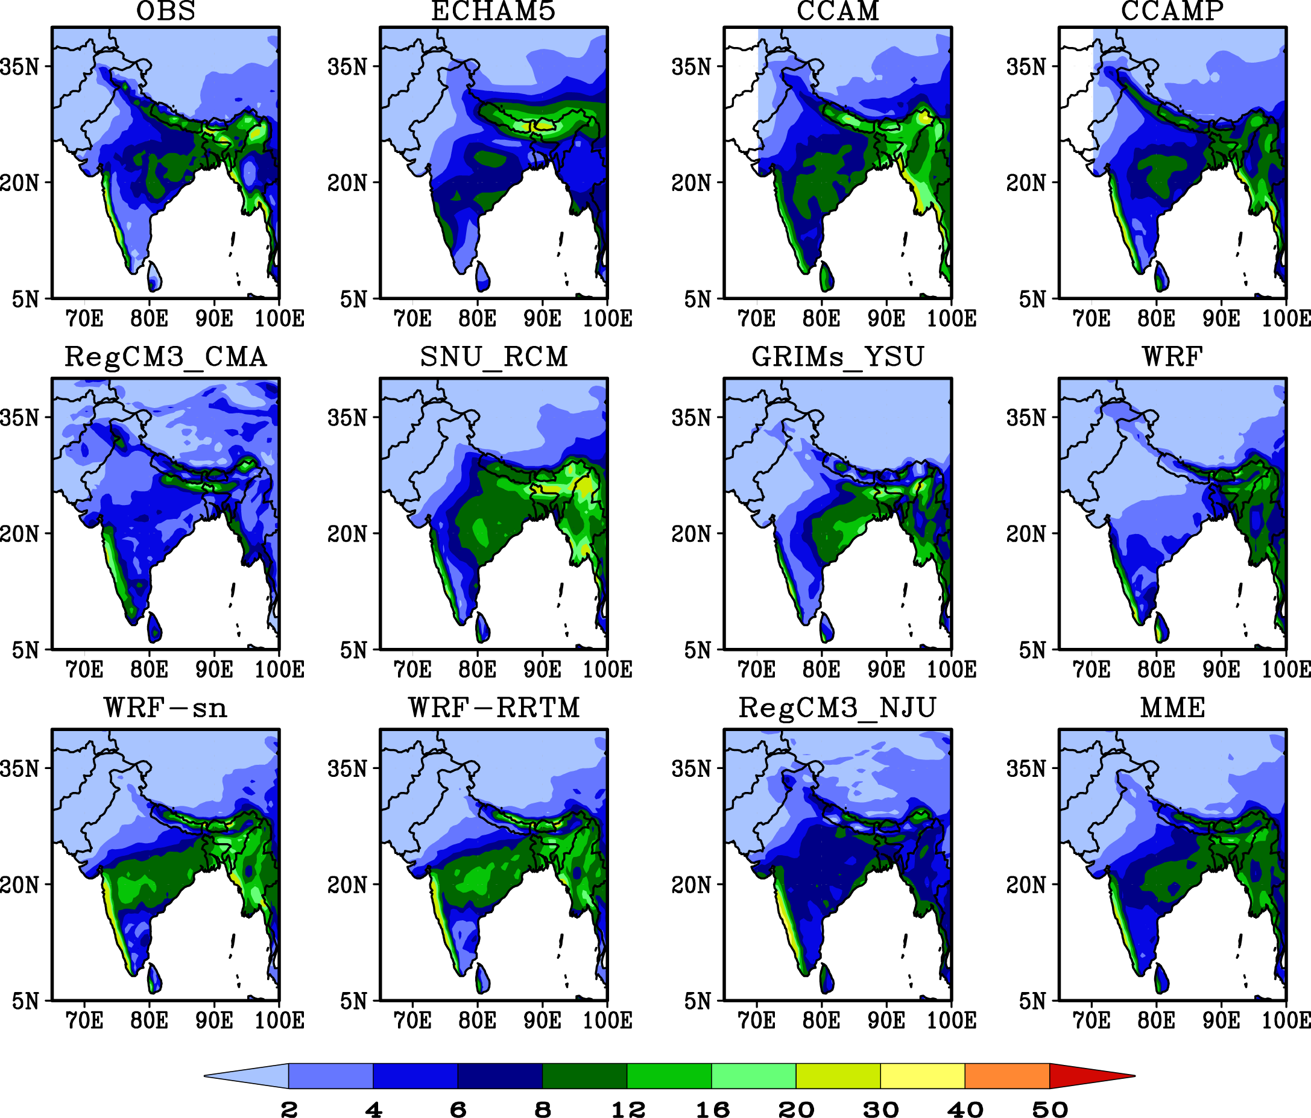
Monsoon Precipitation (JJAS, mm/d) over Indian Subcontinent averaged over 1981-2000

Slide 27
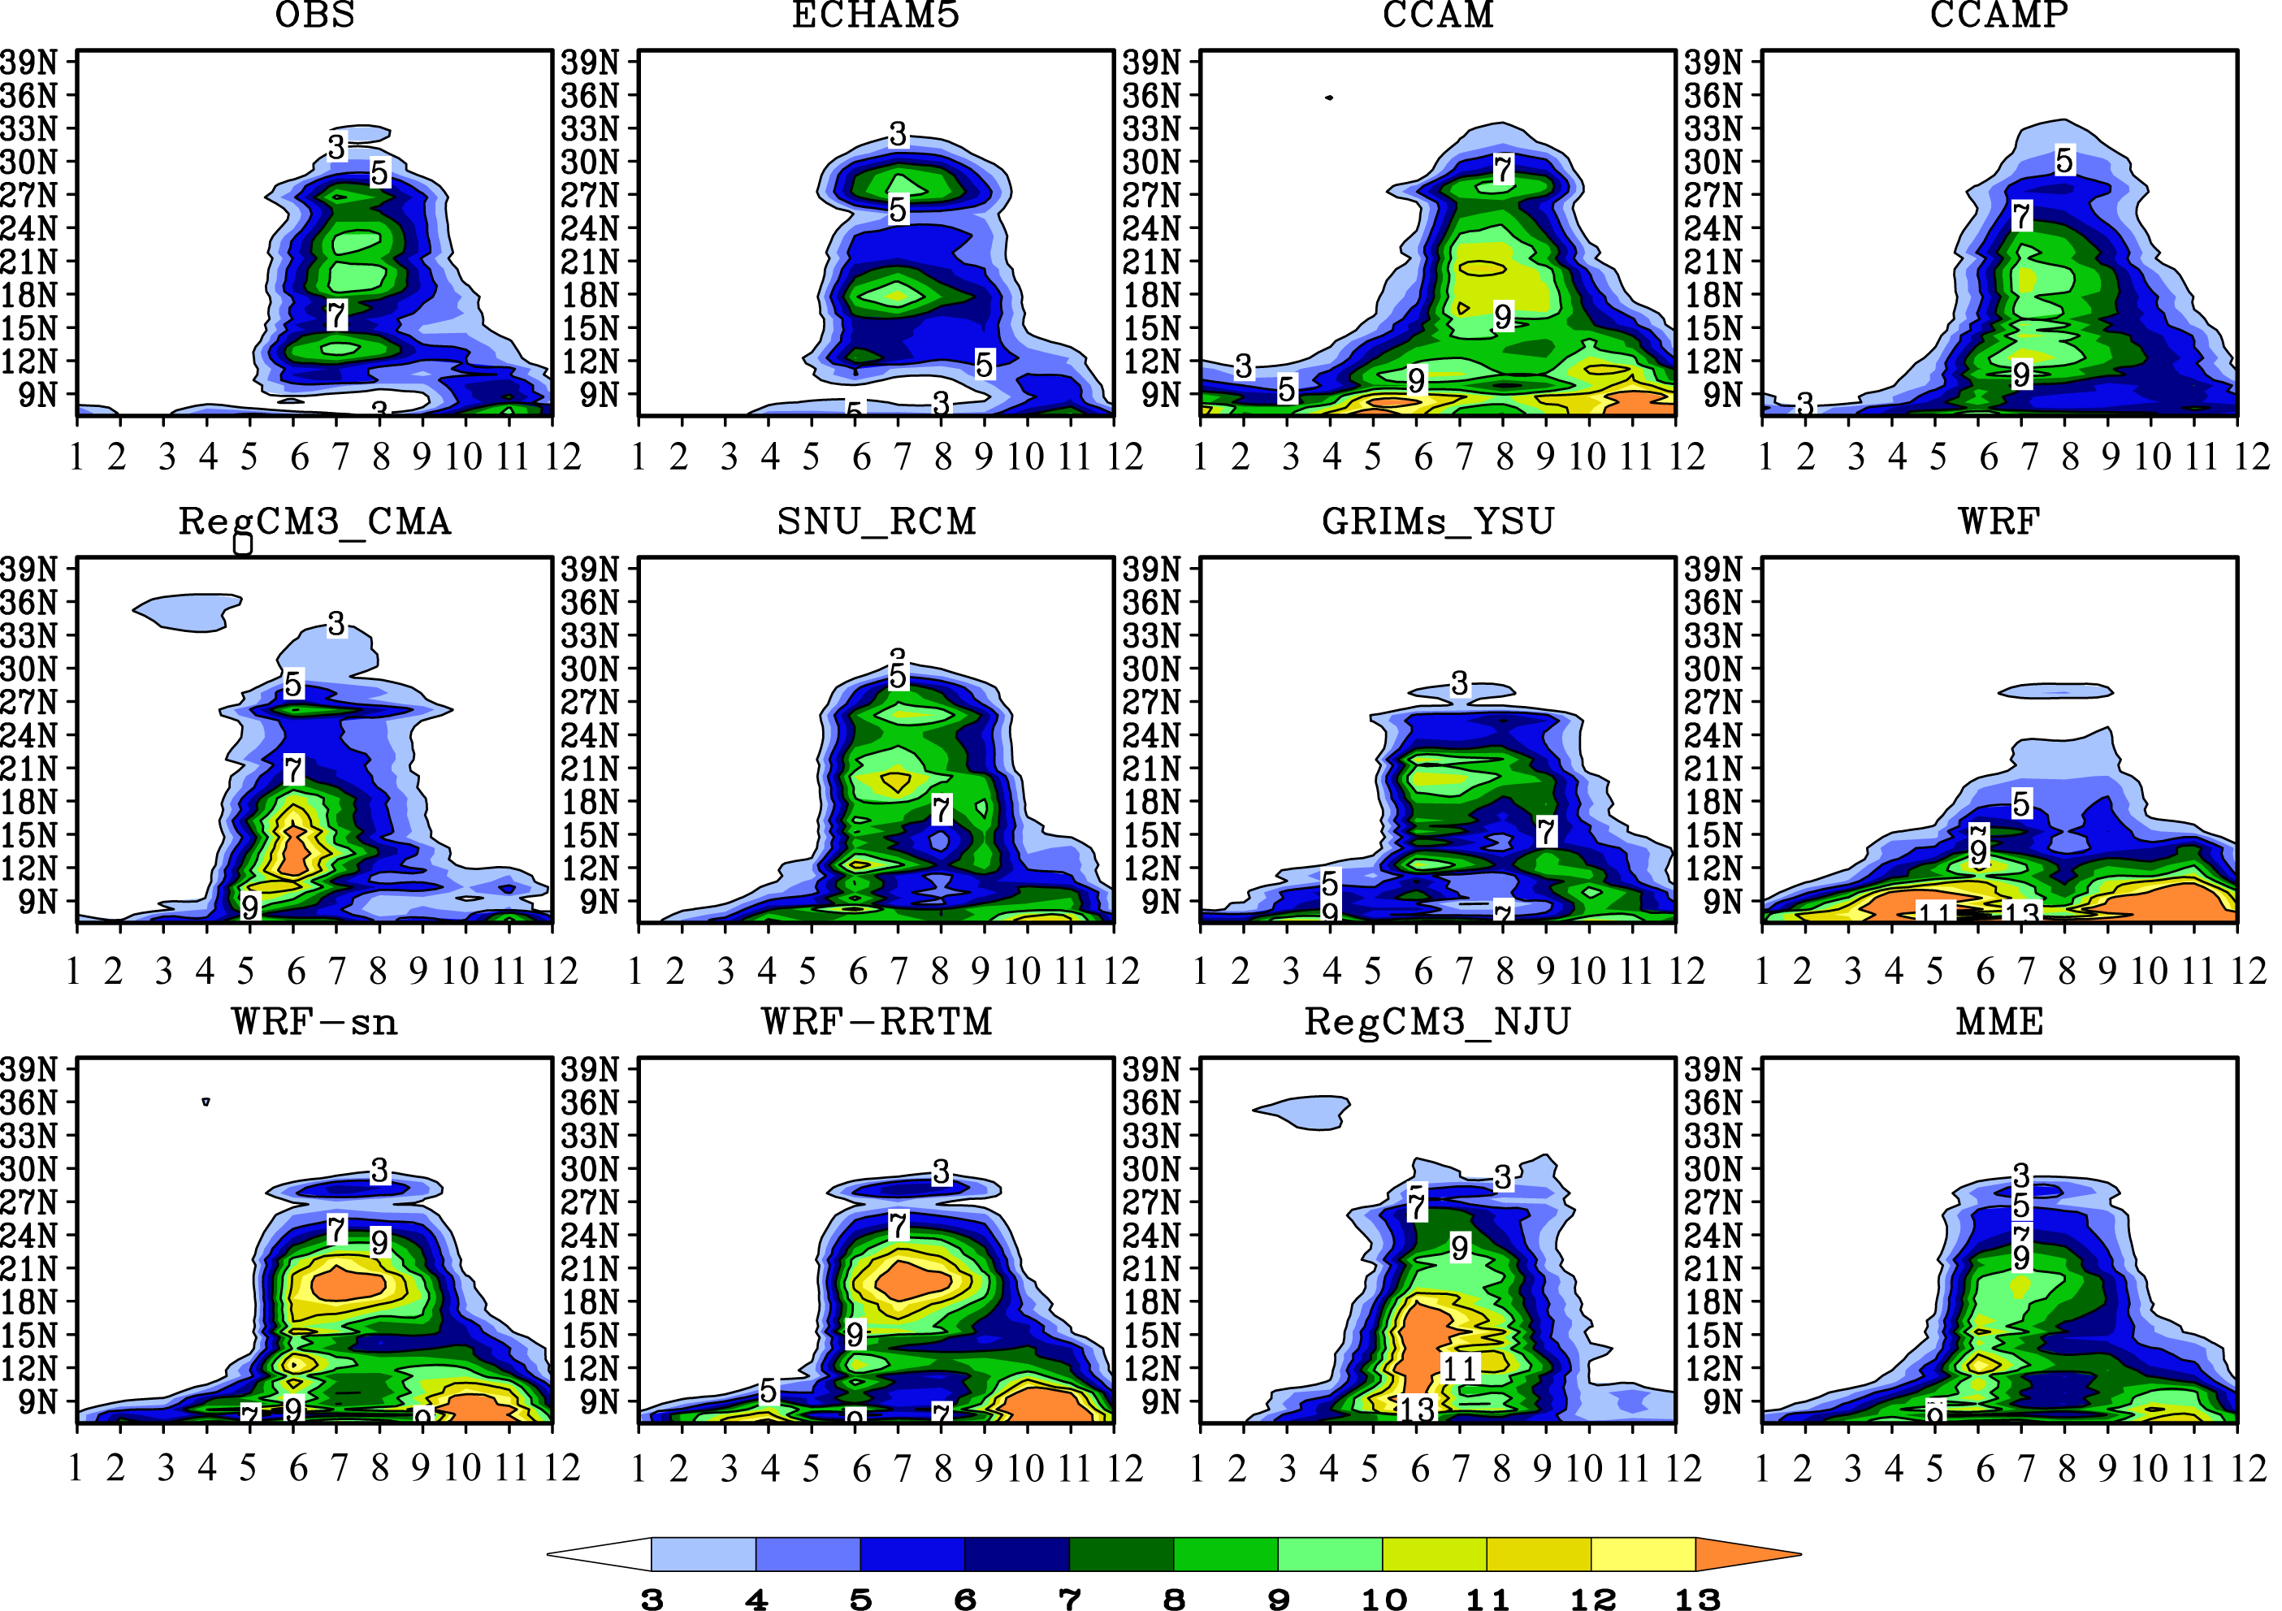
Seasonal migration of the rainband (mm/d) zonally averaged
between 70°and 90°E

Slide 28
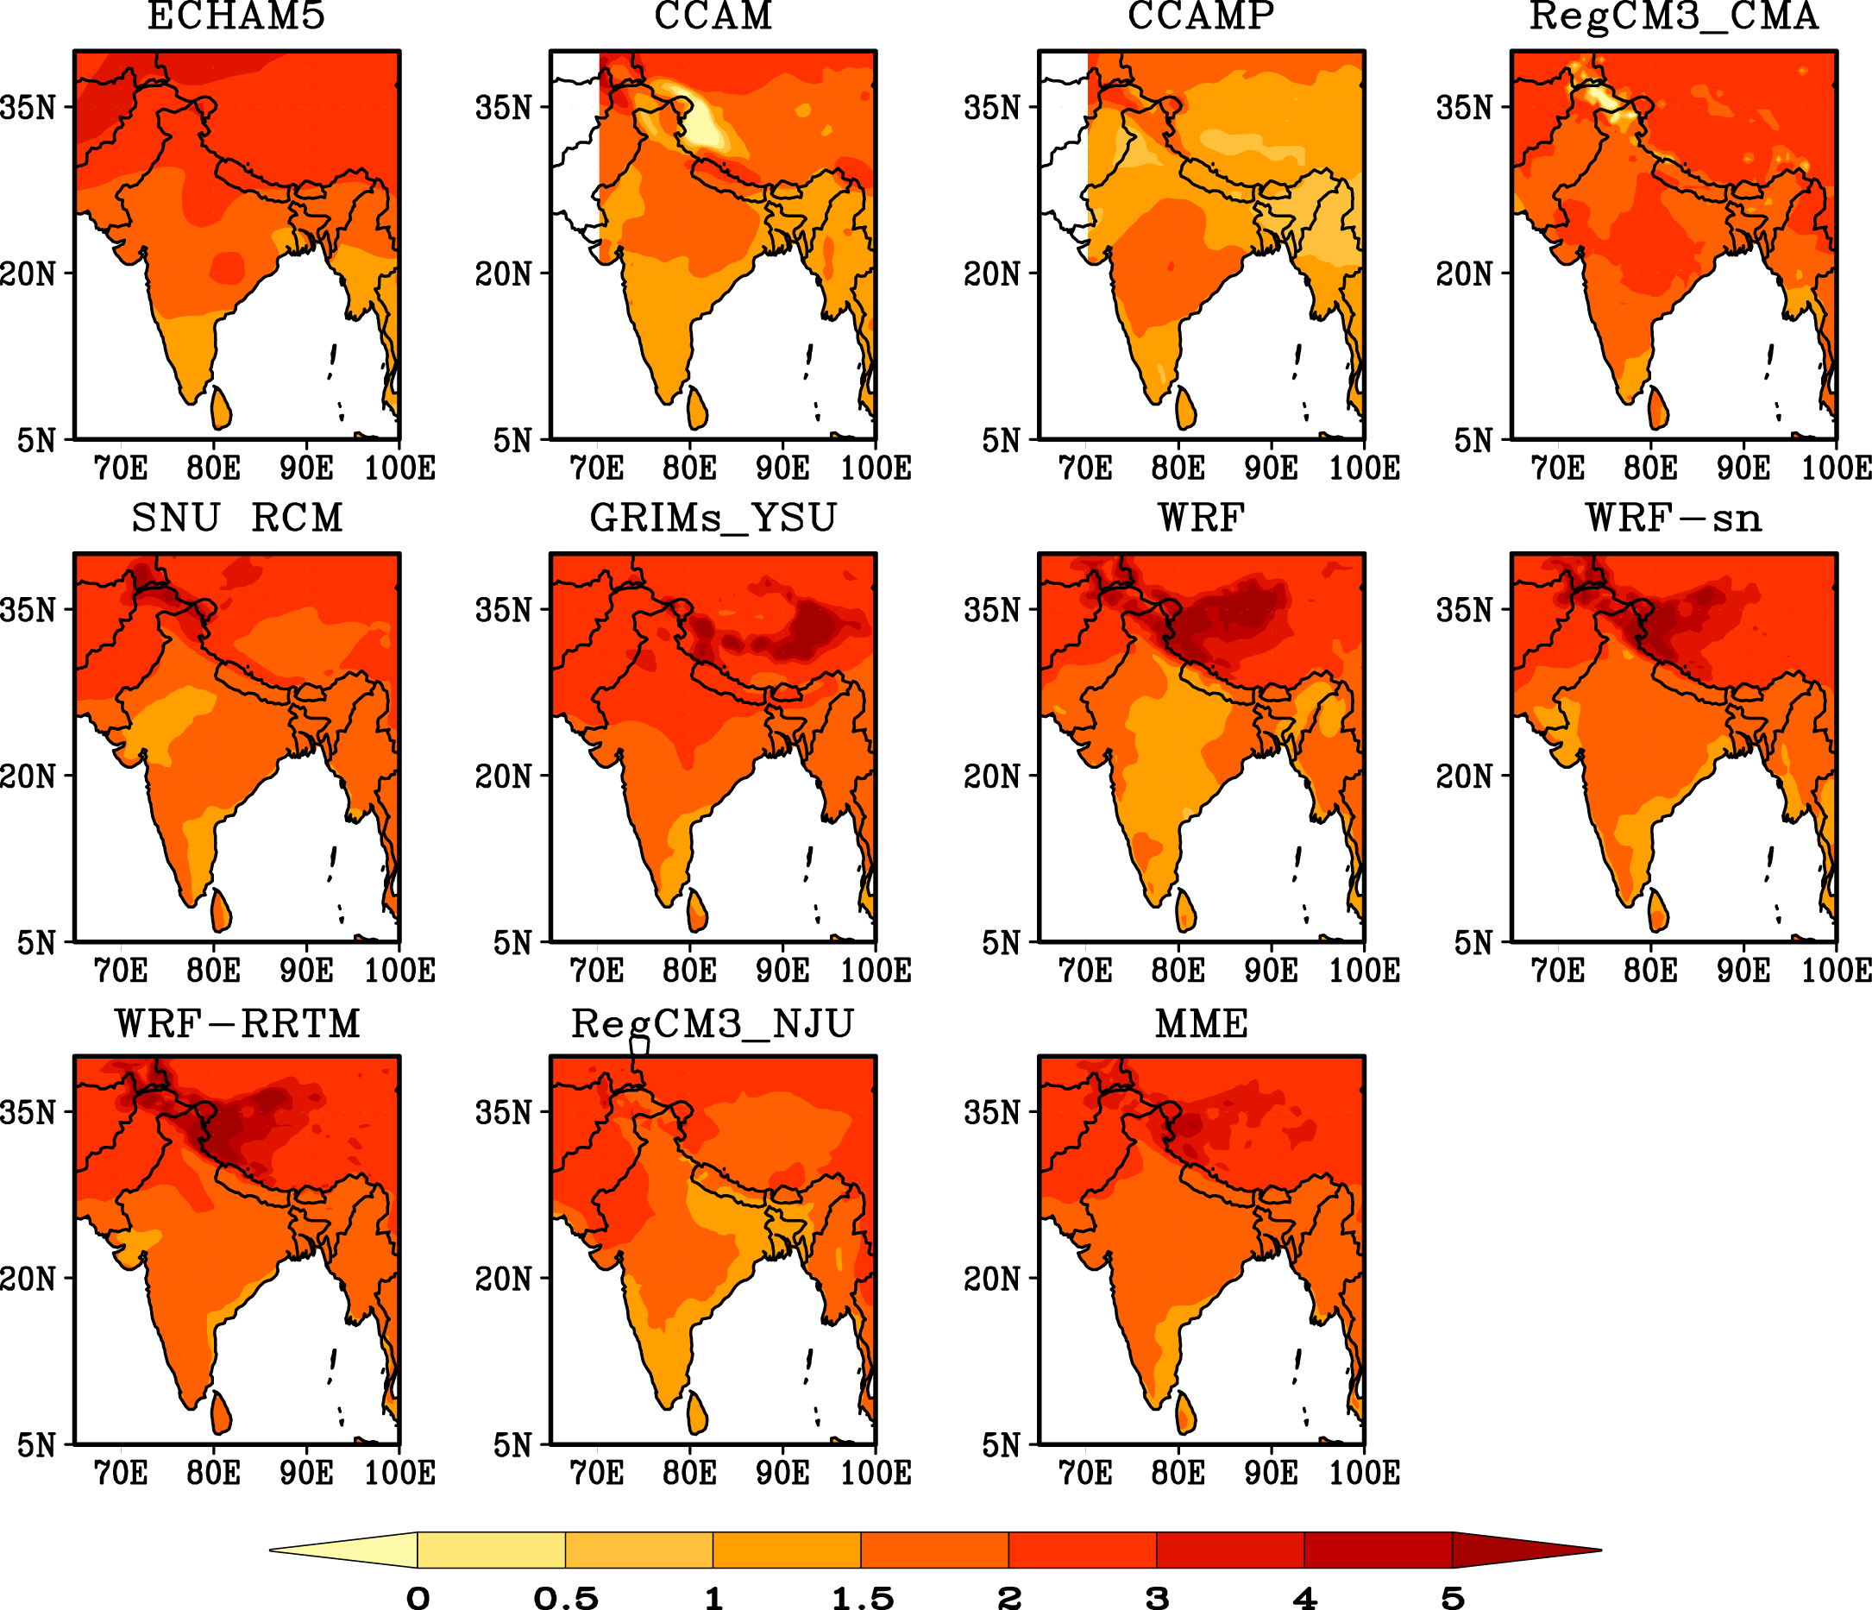
Differences in 2-m temperature (°C) between the future (2041-2060) and current
for summer (JJAS)

Slide 29
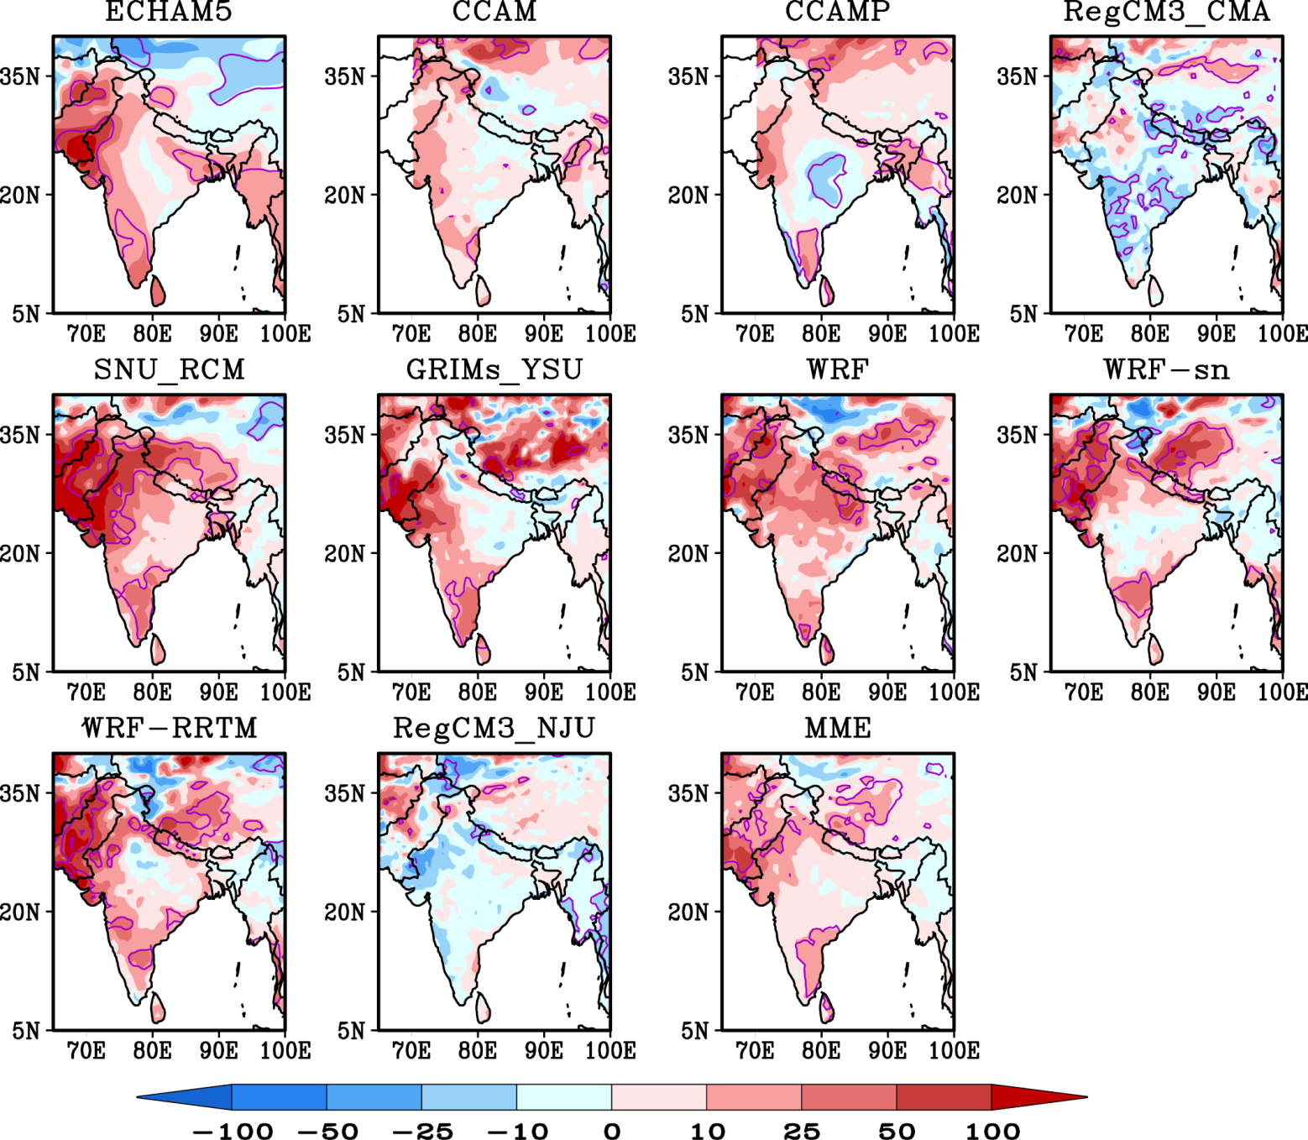
Projection of precipitation changes over Indian Subcontinent (JJAS, % )
(future-current)
current
*100
Purple circles indicate the differences are
significant at a 95% or greater
confidence level

Slide 30
Temporal Variation of Indian Summer monsoon index (ISMI)

Slide 31
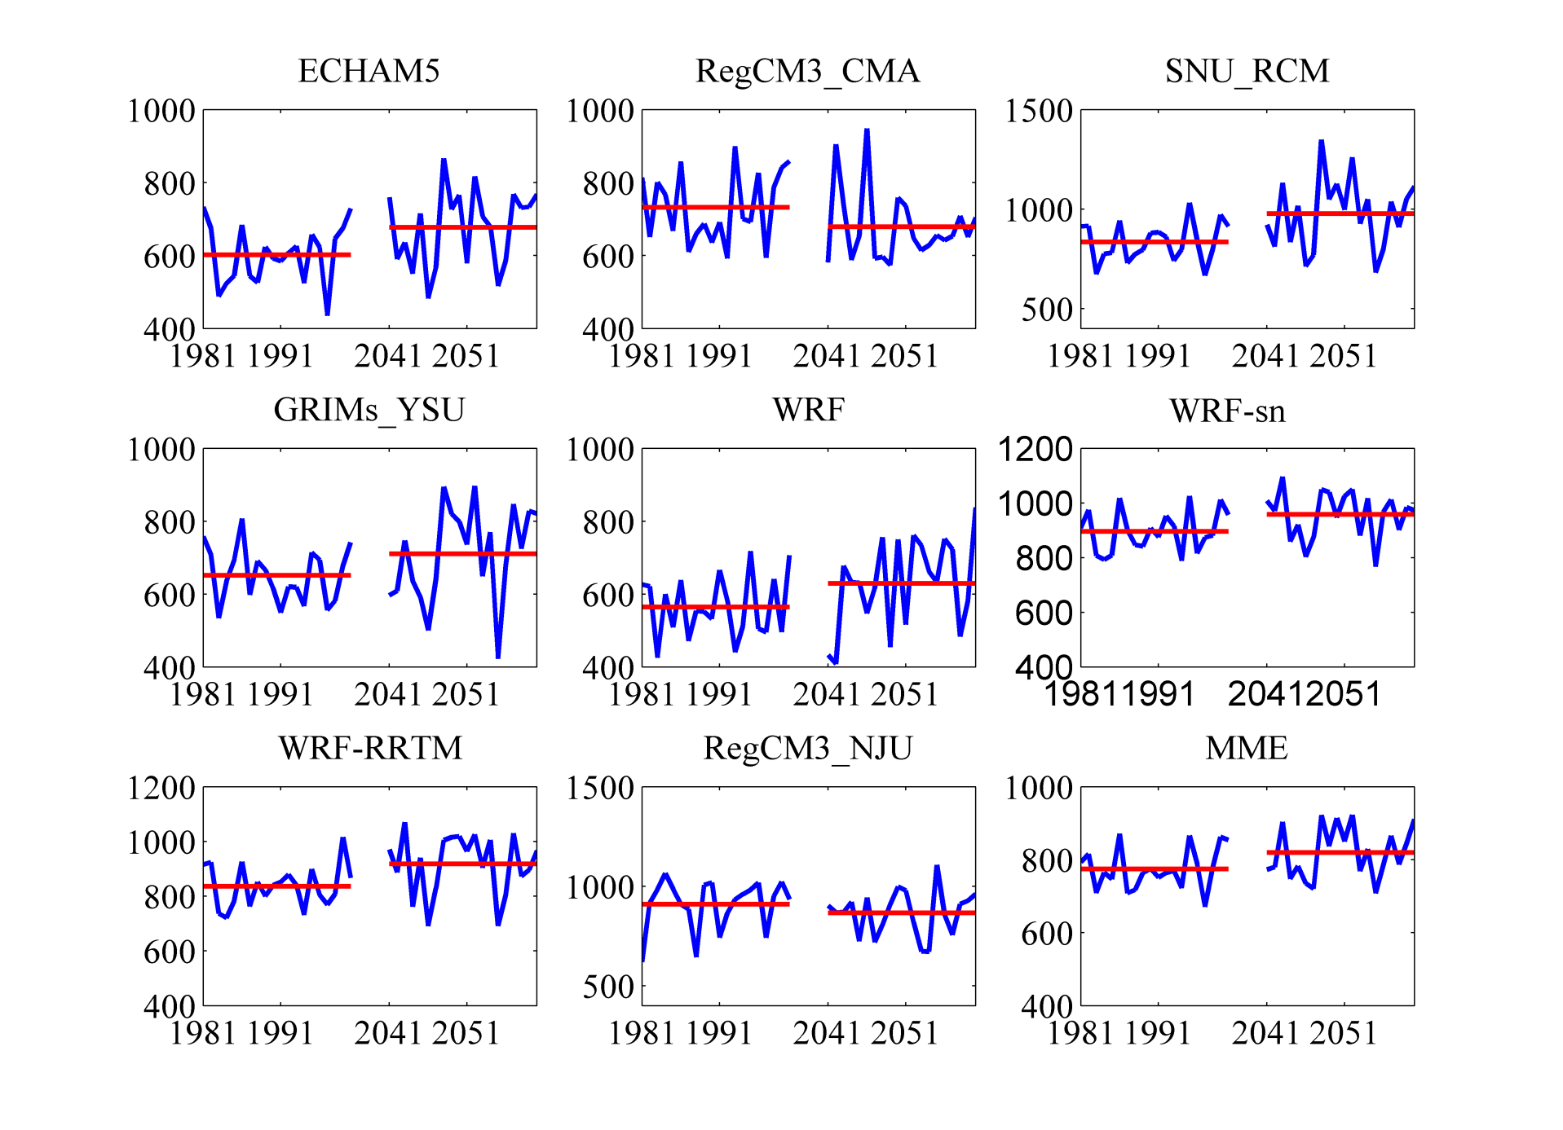
Projected changes in the Indian summer monsoon index (ISMI)
ISMI
ISMI Mean
ISMI: defined by the total rainfall amount from Jun. to Sep. over India , excluding four hilly meteorological subdivisions (Parthasarathy et al. 1992)

Slide 32
Summary
RCMs can capture the climatology over Asian;
For future climate, temperature will increase by up to 3C and show more warming in DJF and higher latitude;
It is likely that Indian summer monsoon will be stronger in the future;
Ensemble averages work well for mean climate;

Slide 33
Thank You

